Slide 1
Joint Research Centre
The European Commission’s in-house science service

Slide 2

GuidosToolbox Workshop
The workshop will address the following topics:
1) Introduction and motivation for new ways of pattern analysis
2) MSPA: Morphological Spatial Pattern Analysis
3) GuidosToolbox: program features and processing options
4) Hands-On examples using a training data set:
a) data preparation
b) MSPA, connectivity, fragmentation, contortion, mosaic, …
c) post-processing: exporting to GeoTiff, Google Earth overlays

Slide 3
GuidosToolbox Workshop
3) GuidosToolbox
Program Features

Slide 4
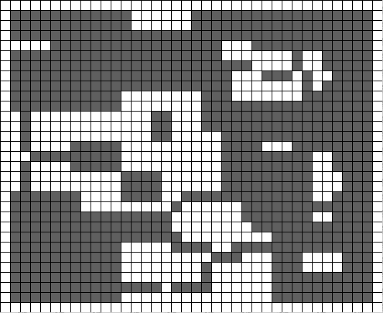



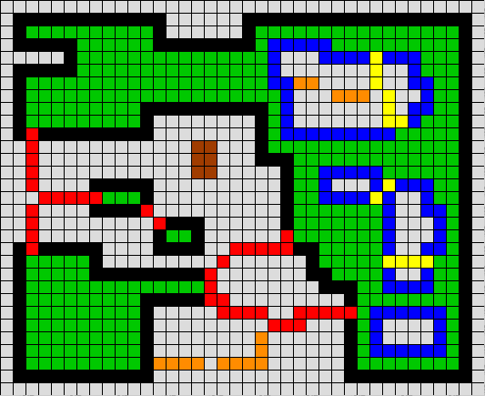
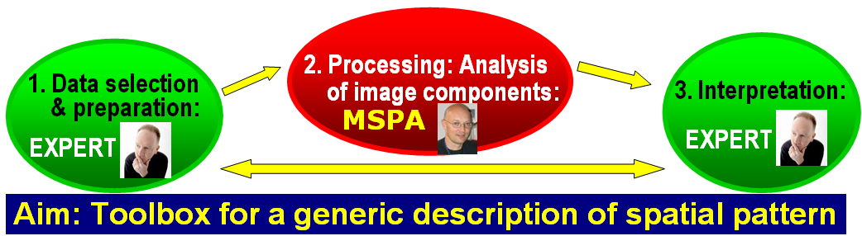
err
Generic Geometric Image Object Analysis
Graphical User Interface for the Description of image Objects and their Shapes
etc.
MSPA & IP-tools
Connectivity
Fragmentation
Contortion
Landscape Mosaic
Distance maps
Change Detection
Gdal, kml-export
GIS-environment,…
4

Slide 5
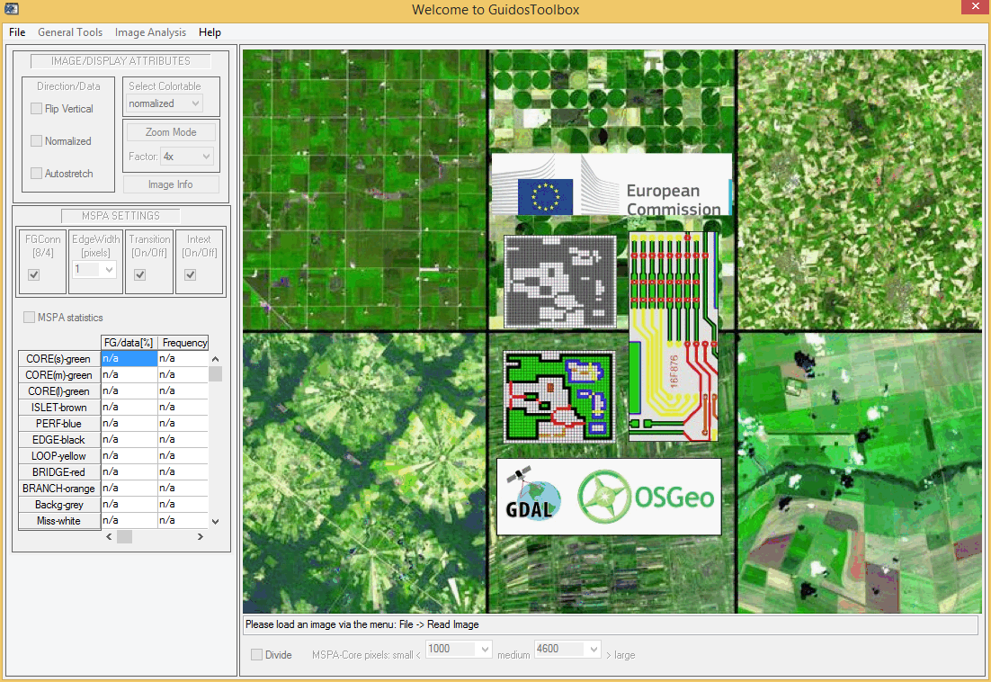
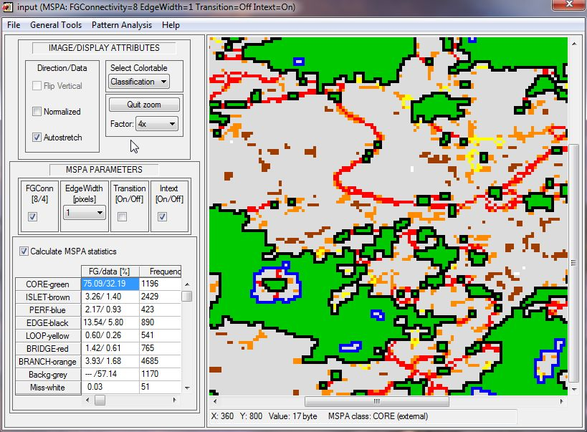
Key Features
Preparing input data
MSPA: data & analysis scale, MSPA-tiling
Network analysis, Fragmentation, Influence Zones,
Contortion, Landscape Mosaic, Change Analysis
GIS-tools, Post-processing options

Slide 6
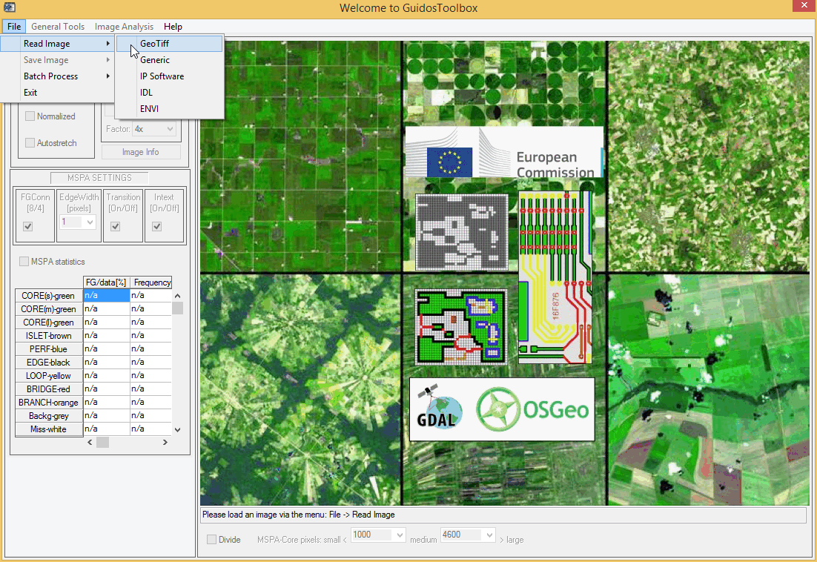
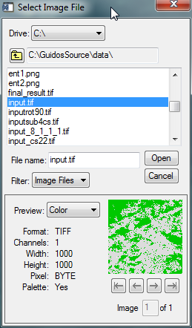
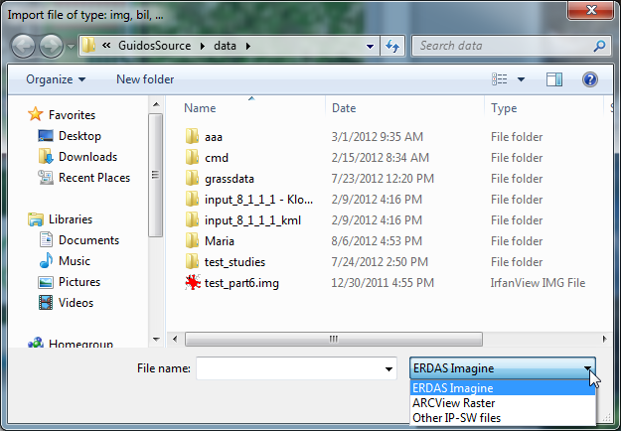
Read Image: various raster image
input formats, default: GeoTiff
Input Formats
Read input image
Generic
IP Software
Notes:
6
6

Slide 7
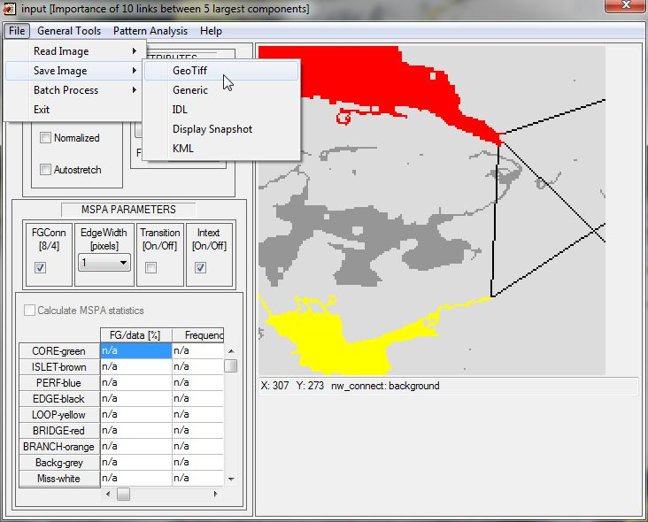
Save Image: various raster image
output formats, default: GeoTiff
Output Formats
Save Options (image & statistics)
Notes:
7
7

Slide 8
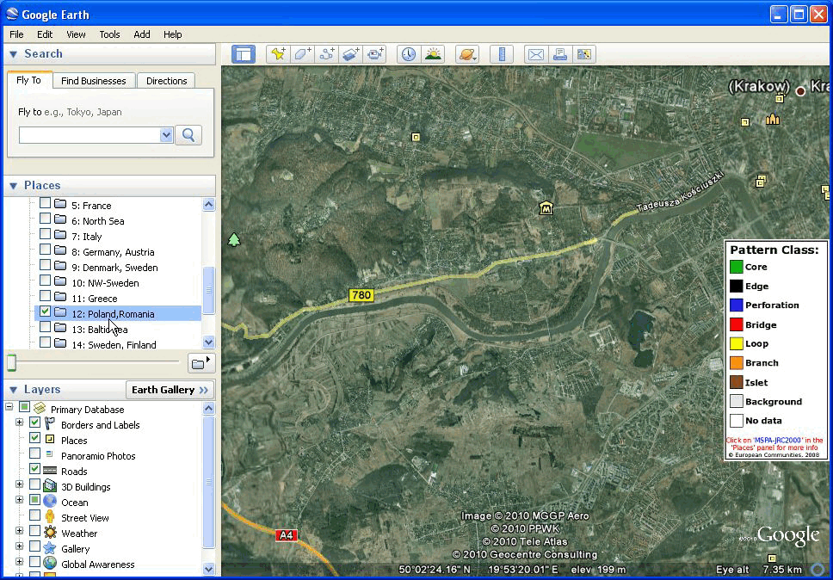
Google Earth overlays
Output Format kml
Notes:
8

Slide 9
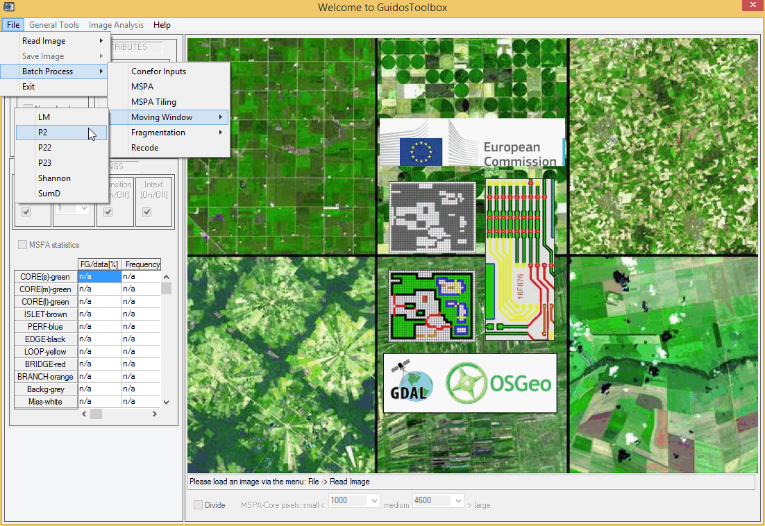
Batch Process: Conefor Inputs,
MSPA(-tiling), Kernel, Fragm., Recode
Batch Processing
Notes:
9
9

Slide 10
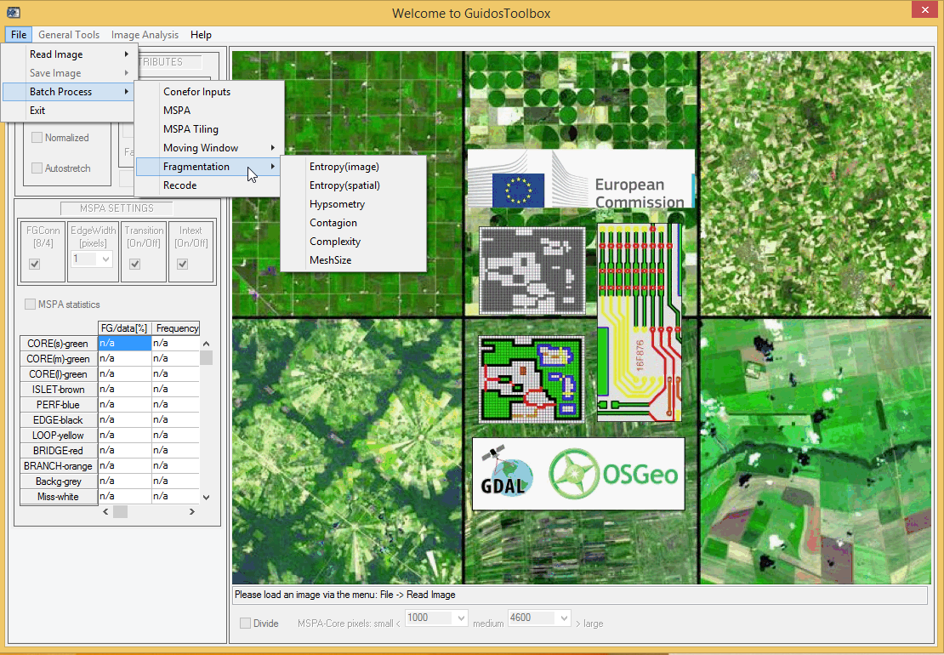
Batch Process: Conefor Inputs,
MSPA(-tiling), Kernel, Fragm., Recode
Batch Processing
Notes:
10
10

Slide 11
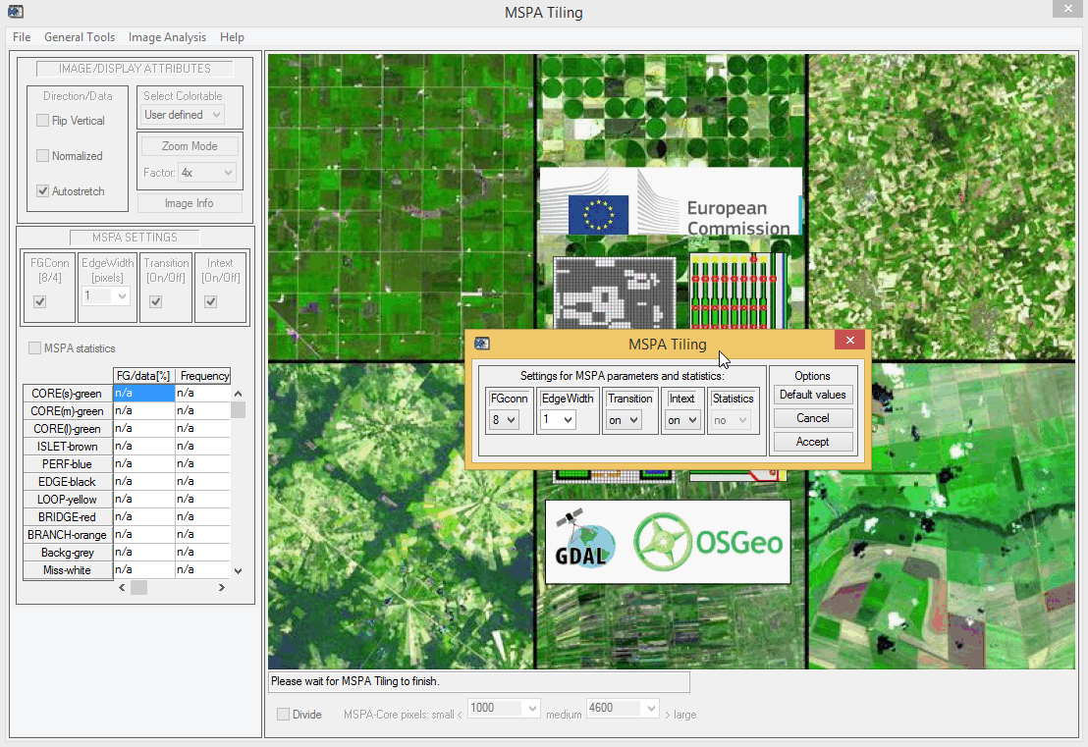
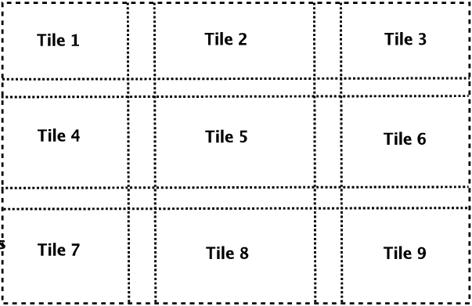
1) GeoTiff 2) buff. subtiles 3) MSPA
4) remove buffers, reassemble, save result
MSPA Tiling
Notes:
11
11

Slide 12
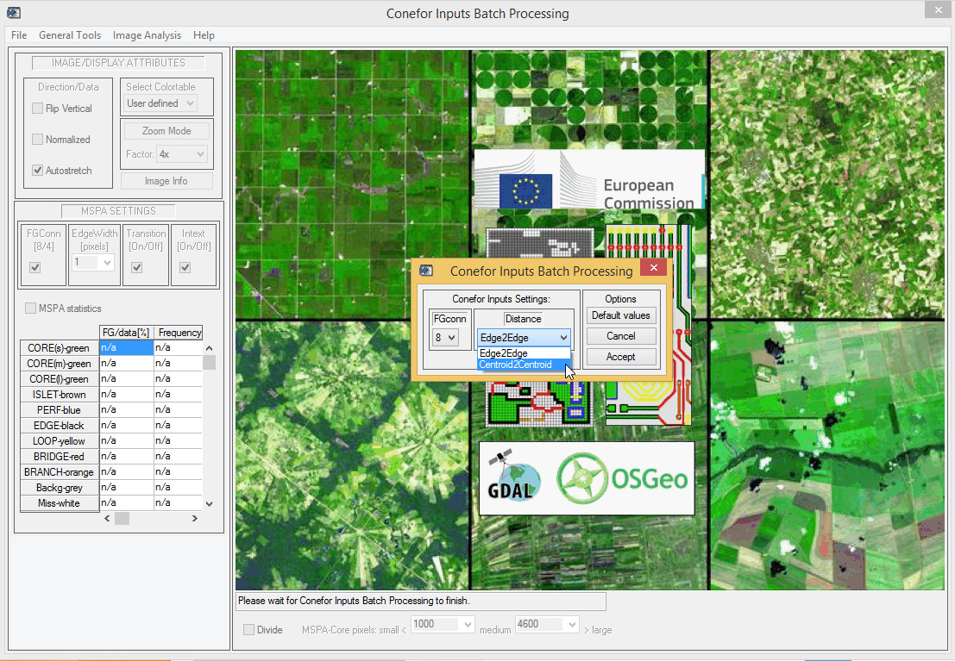
Batch Process: Conefor Inputs,
MSPA, MSPA-tiling, Kernel, Fragmentation
Conefor Inputs
Nodes & Links Table
for graph analysis
Notes:
12
12

Slide 13
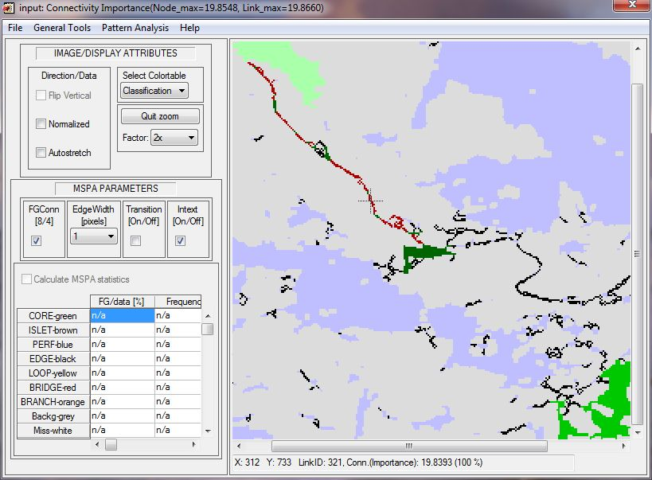
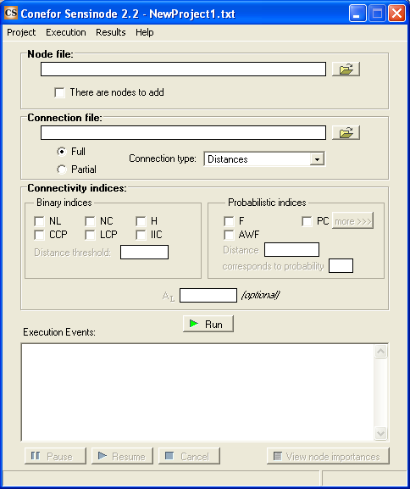

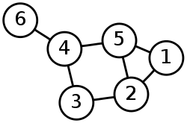
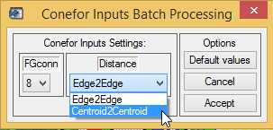
GT → Image Analysis → Connectivity →
MSPA Conefor Inputs
Connectivity analysis (1): from MSPA raster data to Conefor
MSPA: Detect core (nodes) & bridges (links)
Conefor: Quantify their importance
MSPA + Graph Theory
+
Connectivity analysis (2): from any raster data to Conefor
GT → Batch Process →
Conefor Inputs
Notes:
13

Slide 14
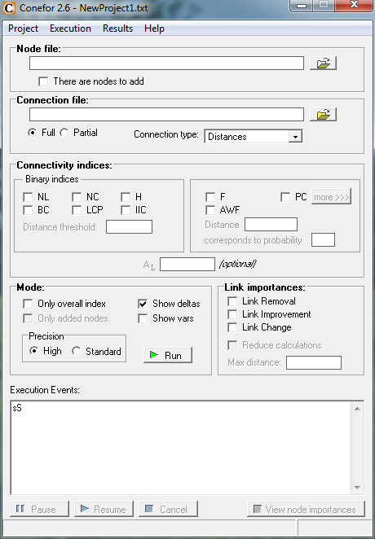
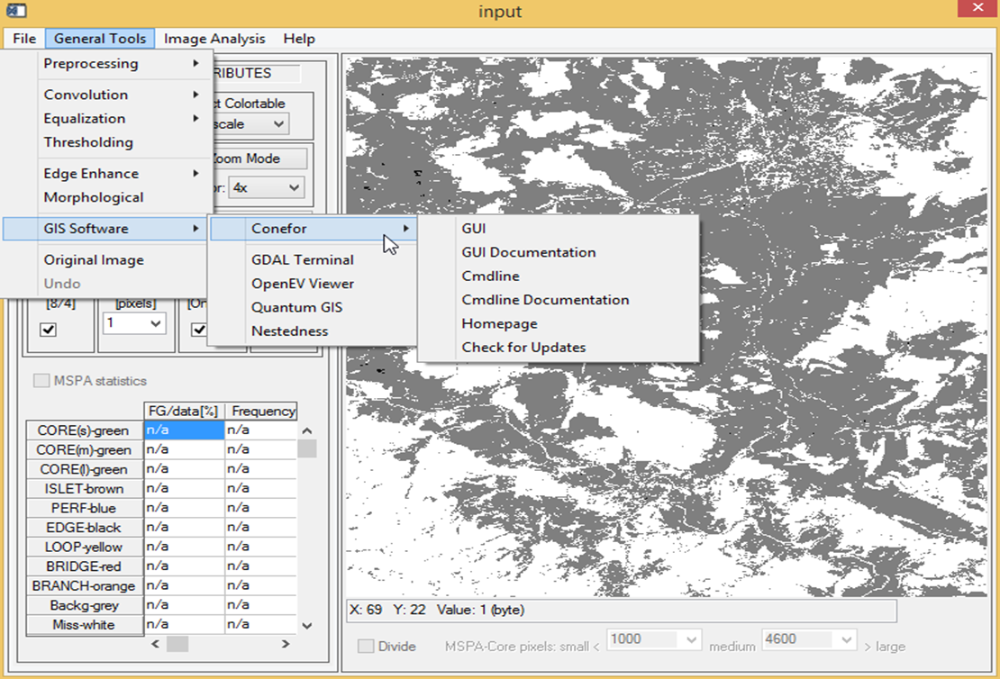
Conefor: http://www.conefor.org
quantify importance of habitat areas and links
Conefor

Slide 15
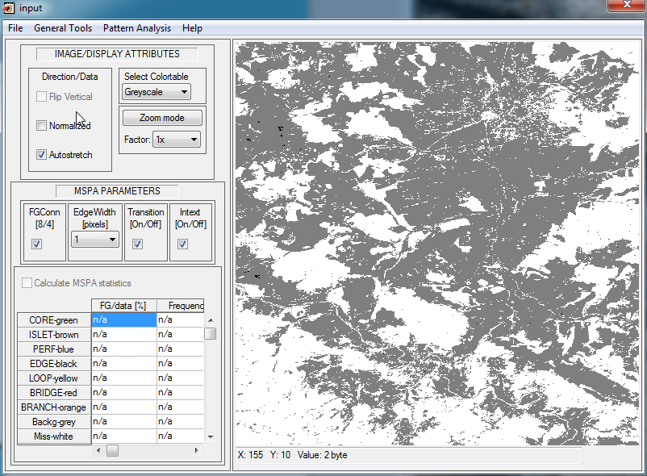
Display options: Flip image,
Normalize/stretch data range
Display Options
Flip Vertical :
swap image ‘upside-down’ (non-GeoTiff)
Normalized :
scale data to [0, 100]
Autostretch :
scale [0, 255] byte colortable to data range
Notes:
15

Slide 16
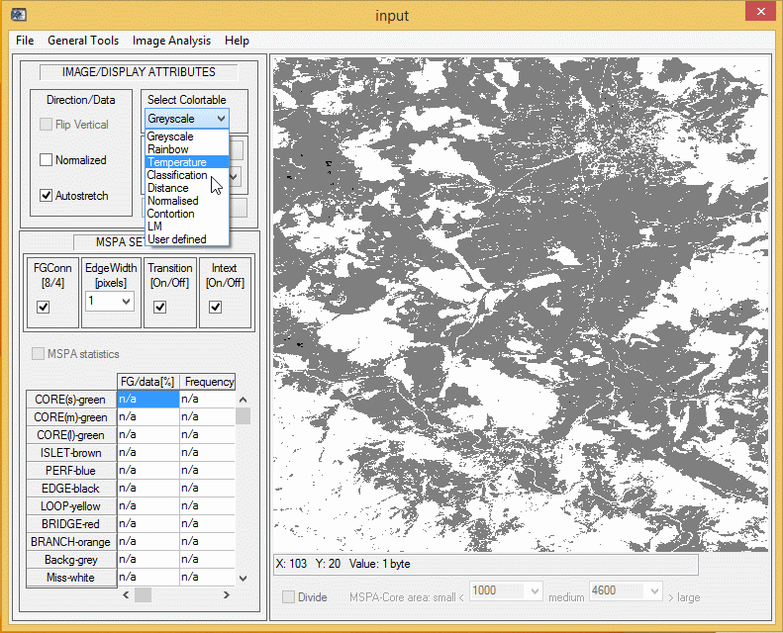
Display options: Colortable
Display Options
Notes:
16

Slide 17
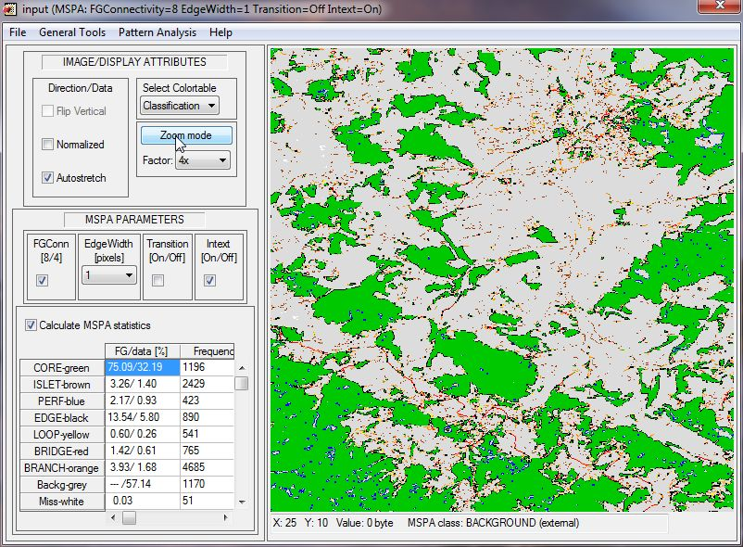
Display options: Zoom mode
Display Options
Zoom mode/factor
Notes:
17
17

Slide 18
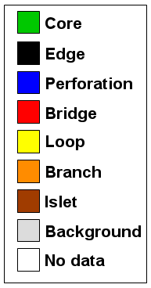
Display options: Zoom mode
Display Options
Notes:
18

Slide 19
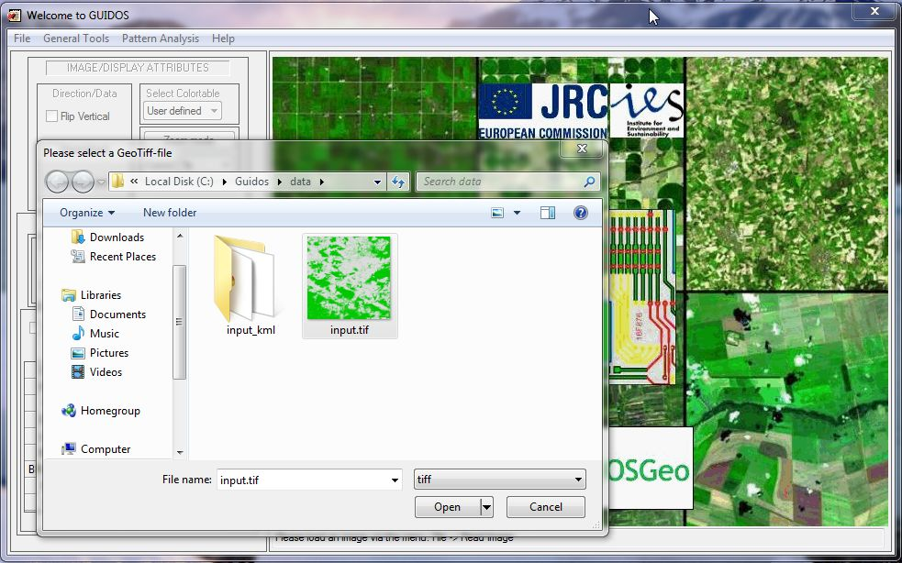
Ex.: MSPA and network analysis
using test image: input.tif
Pattern Analysis
Read input mask
Notes:
19

Slide 20
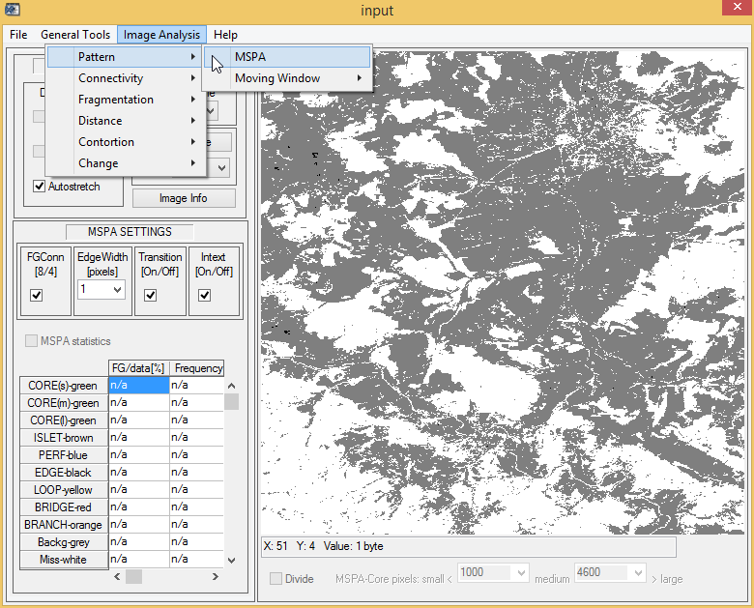
Pattern Analysis: MSPA, Network,
Distance, Contortion, Fragmentation, …
Pattern Analysis
MSPA processing
Notes:
20

Slide 21
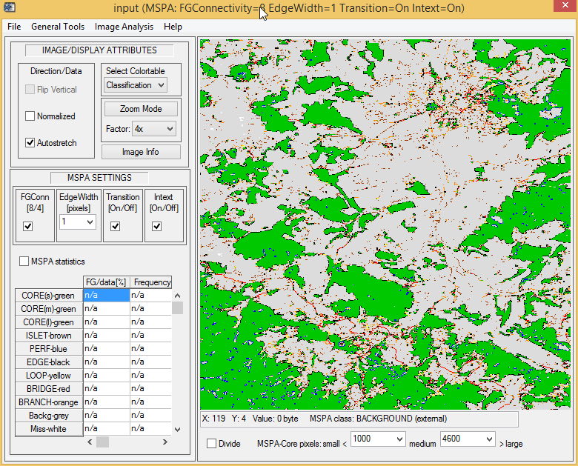
MSPA parameters, MSPA statistics
MSPA analysis
MSPA parameters and classes
Notes:
21

Slide 22

MSPA parameters, MSPA statistics
MSPA analysis
MSPA statistics
Notes:
22

Slide 23
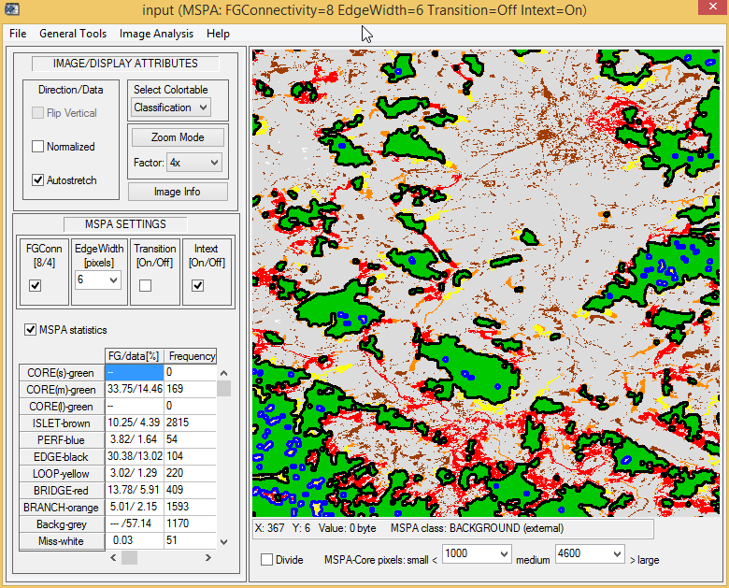
MSPA parameters: FGConn,
EdgeWidth, Transition, Intext
MSPA analysis
MSPA parameters and classes
Notes:
23

Slide 24
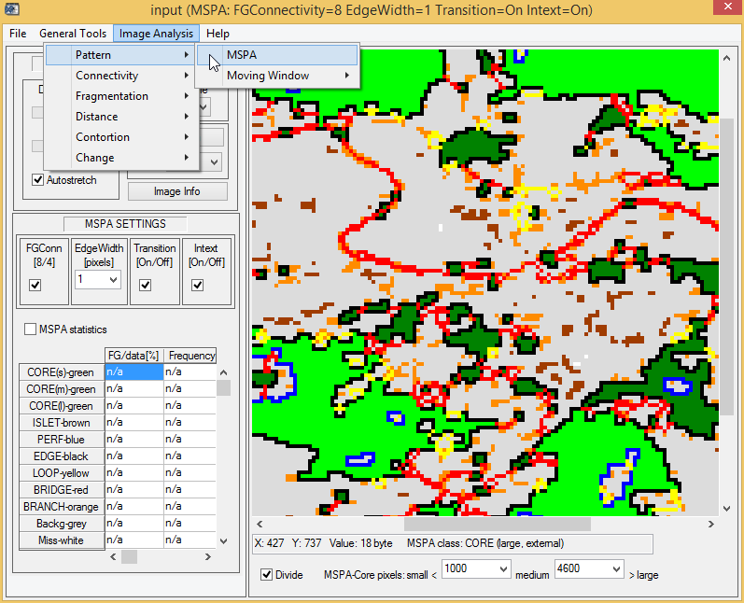
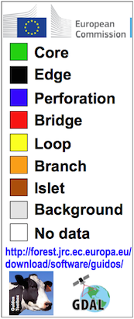
Pattern: MSPA map product
(show geographic hotspots)
MSPA analysis
Connectors
Perforations/area
Core area grouping

Slide 25
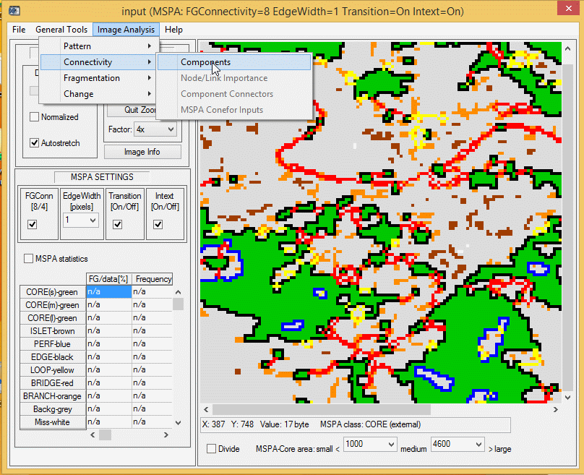
Network Analysis: components,
importance, bridge to Conefor
MSPA → Network
Network Analysis
(Core/Bridge -> Node/Link)
Notes:
25

Slide 26
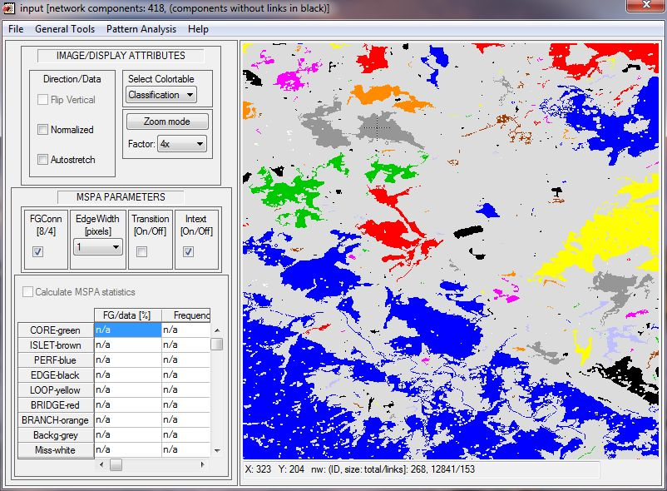
Network Analysis: components
(interconnected set of nodes & links
Network Analysis
a) Components
Notes:
26

Slide 27
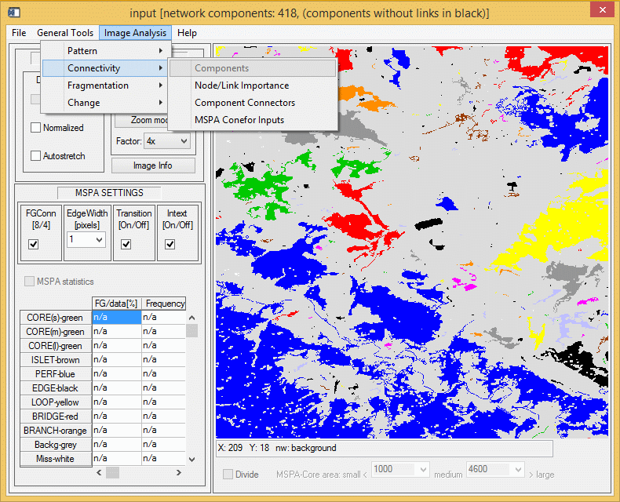
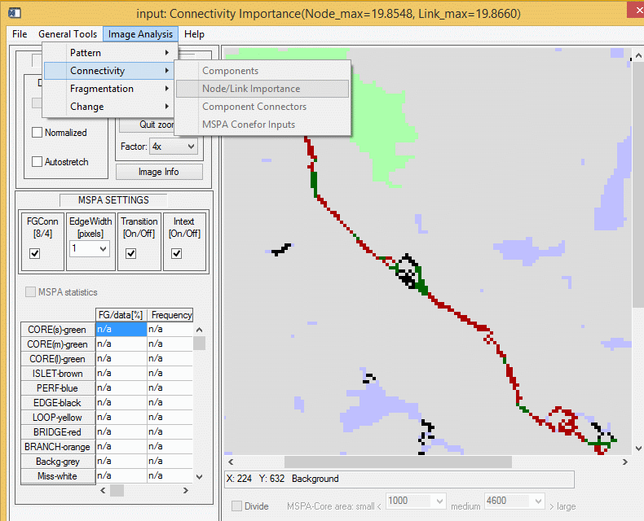
Network Analysis: importance of
each node & link (MSPA ⬄ Conefor)
Network Analysis
MSPA-detected Core +
Bridges ⬄ Components:
Connected set of forest
Nodes/Links
Conefor (graph theory):
Importance ranking of
each forest node/link

Slide 28
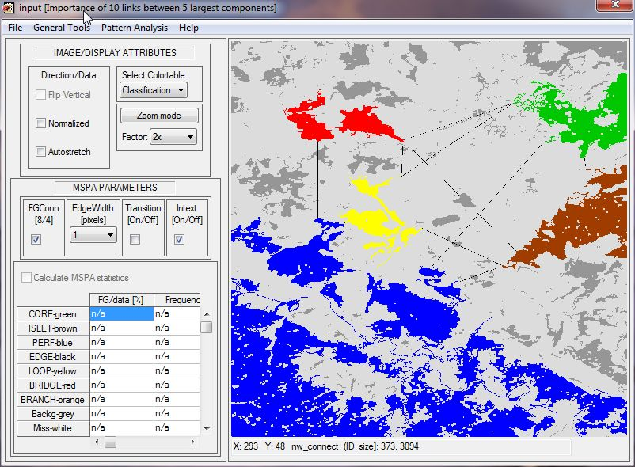
Network Analysis: detect most
important component connectors
Network Analysis
c) Component Connectors Importance
(Conefor)
Notes:
28

Slide 29
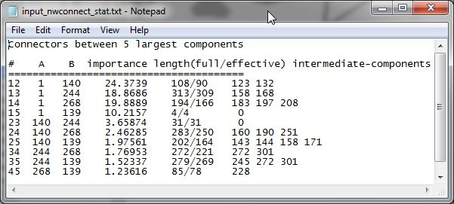
Network Analysis: save image and
statistics to your PC
Network Analysis
Save Options (image & statistics)
Notes:
29

Slide 30

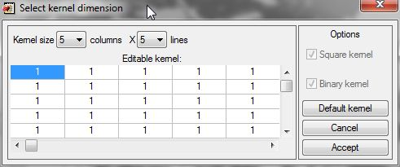
Moving Window: kernel filters for
P2/P22/P23/LM (Riitters et. al.)
Moving Window
Notes:
30

Slide 31
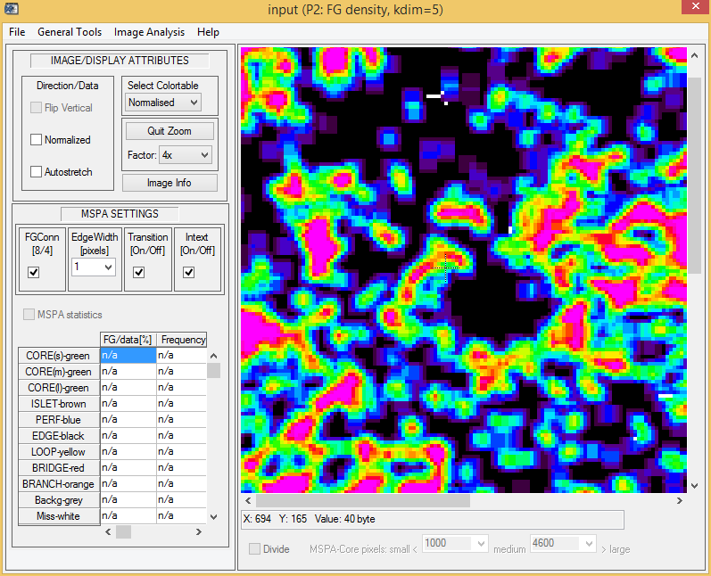
Moving Window: kernel filters for
P2/P22/P23/LM (Riitters et. al.)
Moving Window
Measure spat. features
geometric concept
not species specific
monitor & quantify
forest attributes
compare maps
measure progress in
political programs
and directives.
Notes:
31

Slide 32
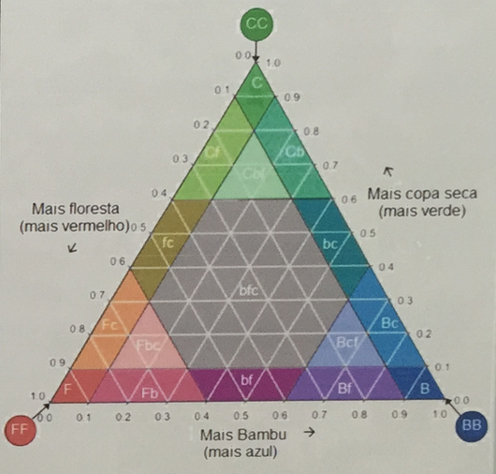
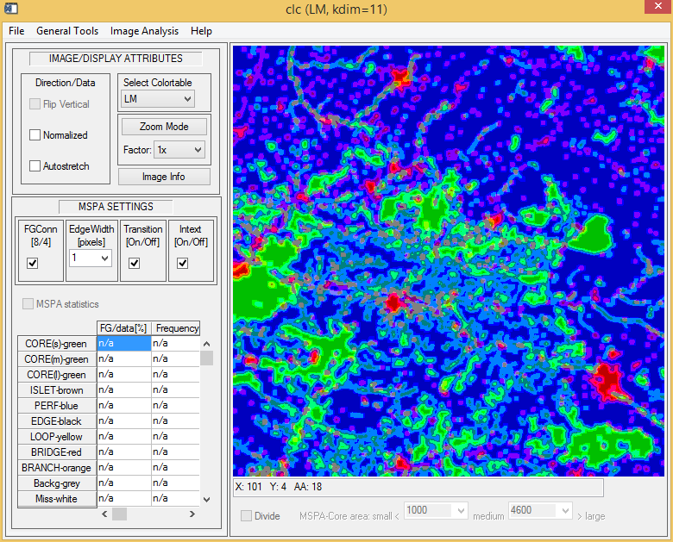
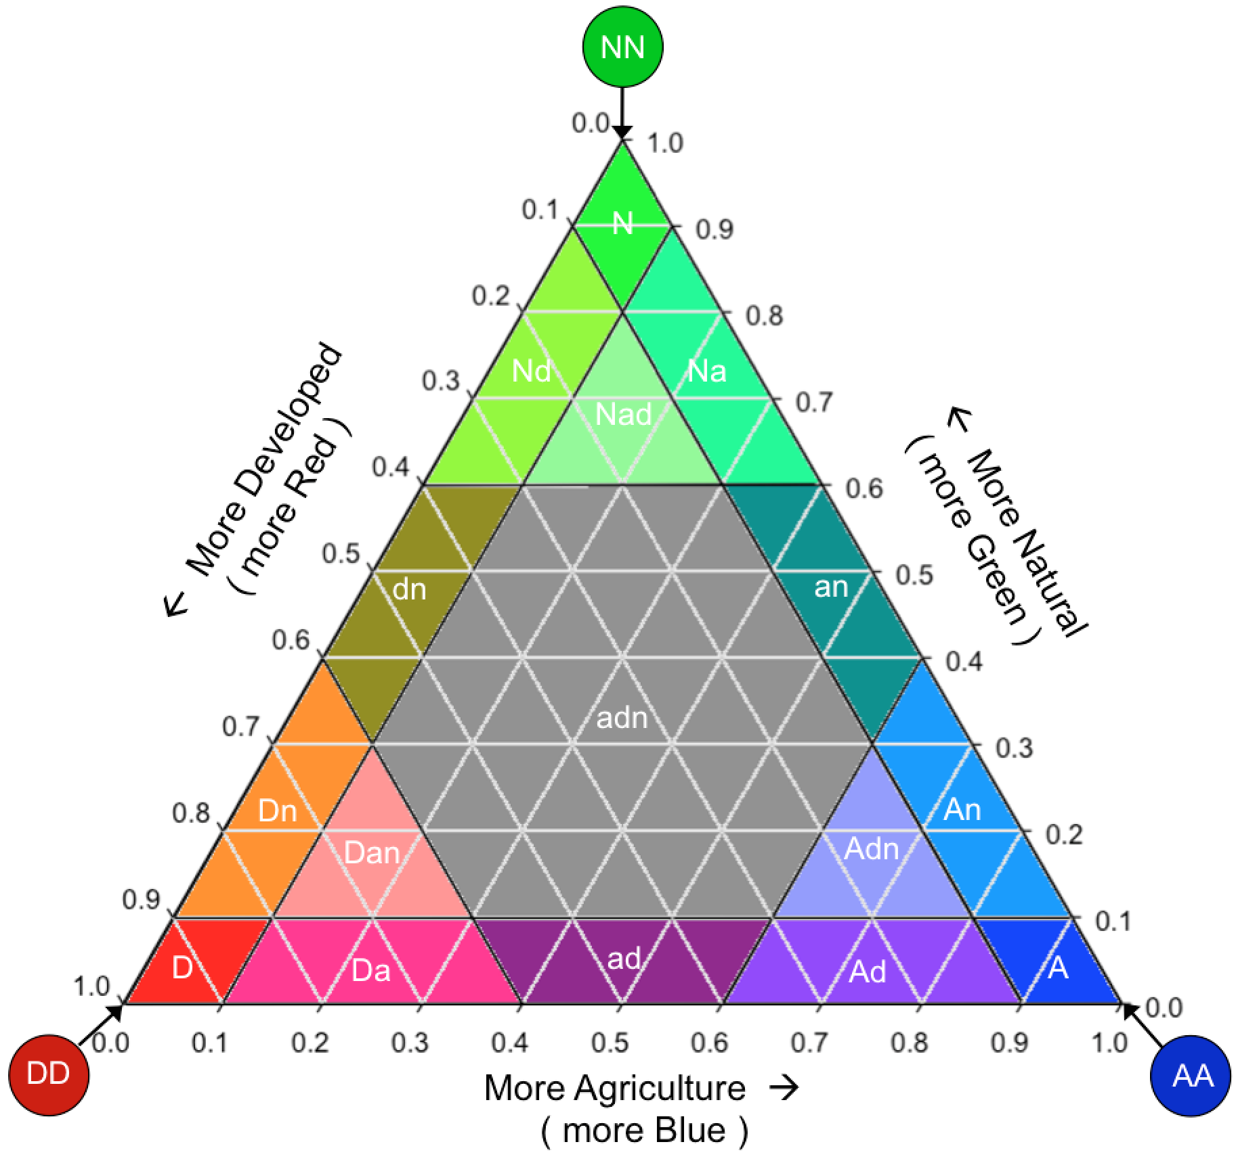
Tri-polar classification:
(Agriculture/Natural/Developed)
Landscape Mosaic
Measure composition
geometric concept
monitor & quantify
influence of the three
components

Slide 33
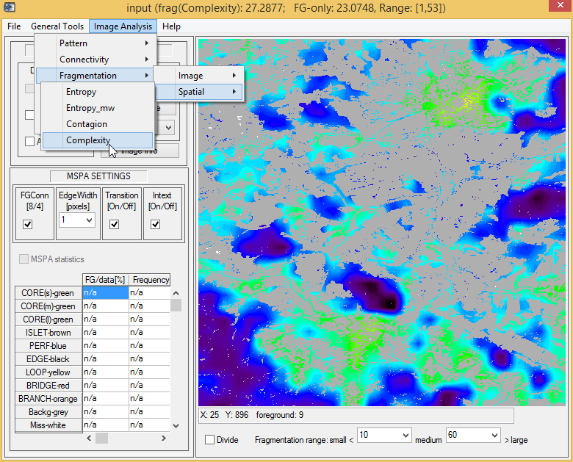
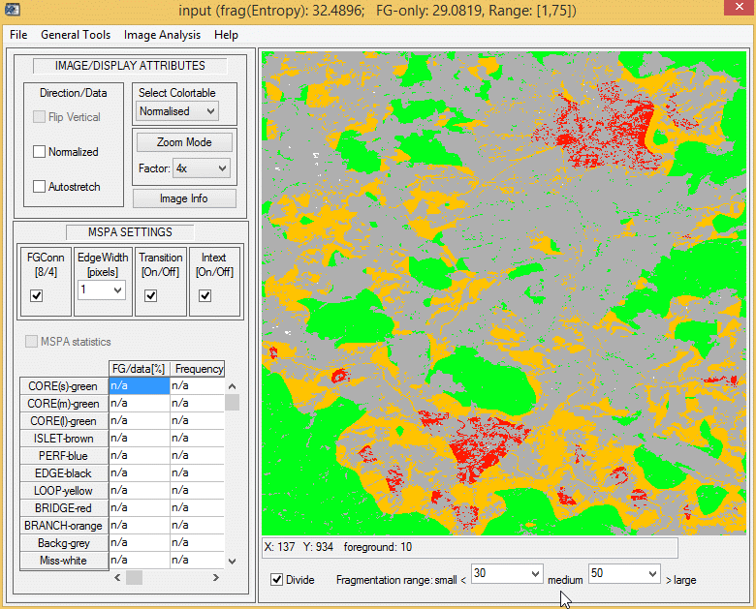
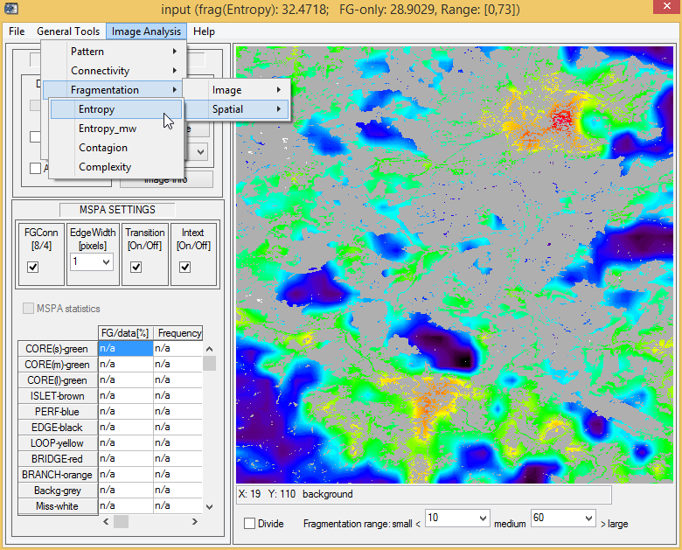
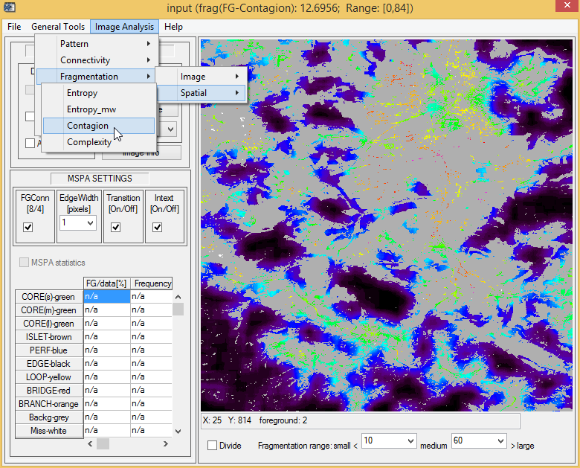
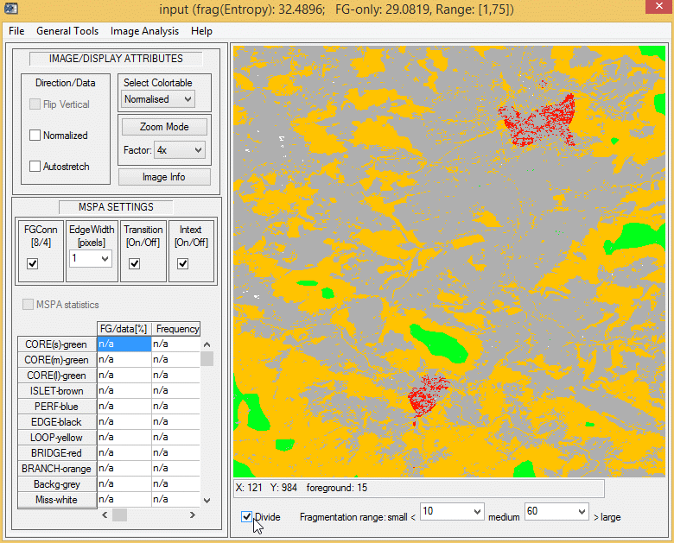
Fragmentation
Quantitative forest degradation [%]
Measure fragmentation
geometric concept
not species specific
Monitor & quantify
compare maps
measure progress
in political programs
and directives.

Slide 34
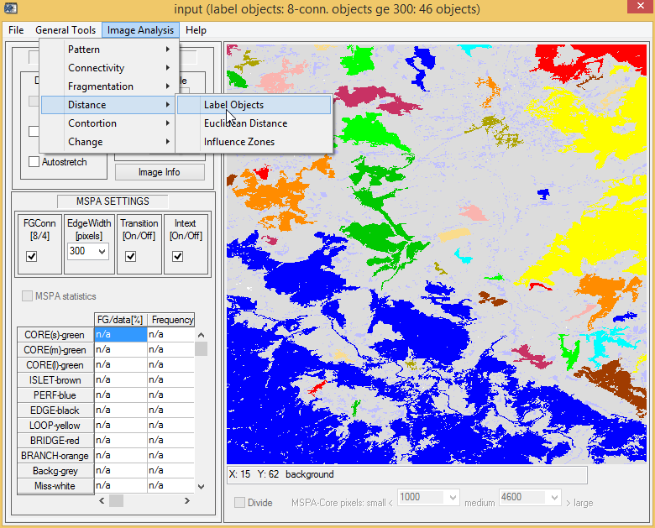
Distance: label objects
f(8/4-conn., minimum size)
Distance Analysis
Notes:
34

Slide 35
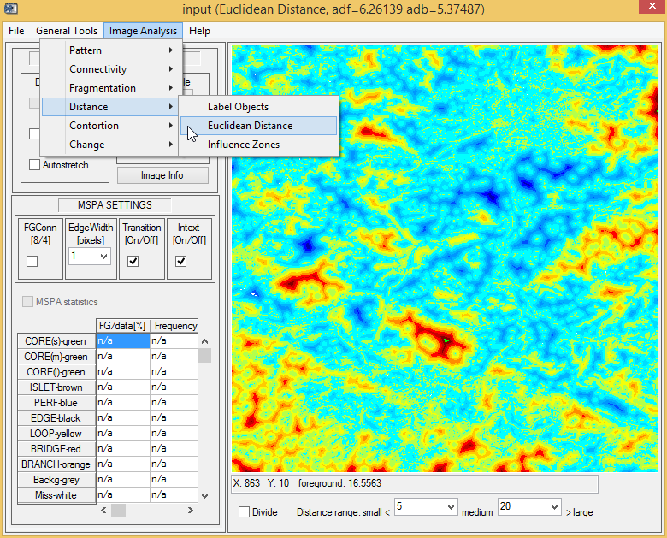
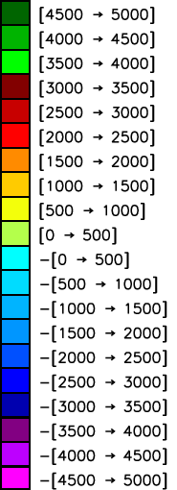

Pseudo-elevation map; adf/adb:
average distance in FG/BG [pixels]
Distance Analysis
Depth [m]
Notes:
35

Slide 36

Pseudo-elevation map; adf/adb:
average distance in FG/BG [pixels]
Distance Analysis
Range classes:
Small/medium/large
In both, foreground
and background
Notes:
36

Slide 37


Influence zones and optional
buffer zones to define outreach area
Distance Analysis
1) 8/4 connectivity
2) min. (core-)object
area for calculation of
influence zone
3) FG-buffer to define
core-objects
4) BG-buffer to define
outreach/impact zone
Notes:
37

Slide 38

Cost surface, least cost path,
user-driven cost zones
Cost Analysis
A) Calculate cost surface
from resistance map for a
given point or object.
B) Combined cost map
between two points/objects
providing cost surface
and least cost path.
User can set threshold(s) to
highlight cost range zones.

Slide 39



Example: road map, shortest
path, cost zones
Cost Analysis
Find alternative pathways of similar cost
Simulate pest/fire/flood/ climate & LULC change - impact on movement
Generate isochrones & feed into DEA (travel times – real estate evaluation
A
B

Slide 40

Object regularity:
anthropogenic vs. natural
Contortion
Count changes in
direction of object
perimeter:
low count for regularly
shaped objects
(buildings, agric. fields)
vs. higher count for
natural objects.
User can set threshold
to group contortion.

Slide 41

Change Detection: (morph.)
essential gain & loss areas, elasticity
Change Detection
Forest loss areas
Forest gain areas
Elasticity
Small and spurious
changes caused by:
classification accuracy,
image-registration, noise,
acquisition season,
atmospheric correction.
Potentially two different
classification schemes &
sensor data at two times.

Slide 42


Preprocessing: generic tools also
to setup MSPA-compliant binary image
IP Tools & SW
Notes:
42

Slide 43

Preprocessing: generic tools also
to setup MSPA-compliant binary image
IP Tools & SW
Notes:
43

Slide 44

Convolution: user-defined &
generic filters, including wavelet analysis
IP Tools & SW
Notes:
44
44

Slide 45

Convolution: user-defined &
generic filters, including wavelet analysis
IP Tools & SW
Notes:
45
45

Slide 46

Convolution: user-defined &
generic filters, including wavelet analysis
IP Tools & SW
Notes:
46
46

Slide 47

Equalization: user-defined contrast
and equalization routines
IP Tools & SW
Notes:
47
47

Slide 48

Equalization: user-defined contrast
and equalization routines
IP Tools & SW
Notes:
48
48

Slide 49

Thresholding:
interactive thresholding
IP Tools & SW
Notes:
49
49

Slide 50

Thresholding:
interactive thresholding
IP Tools & SW
Notes:
50
50

Slide 51

Edge Enhance: filters for edge
detection, sharpening, skeletonization, etc.
IP Tools & SW
Notes:
51
51

Slide 52

Morphological: interactive
morphological toolbox
IP Tools & SW
Notes:
52
52

Slide 53

Morphological: interactive
morphological toolbox
IP Tools & SW
Notes:
53
53

Slide 54

Morphological: interactive
morphological toolbox
IP Tools & SW
Notes:
54
54

Slide 55


GIS Software: additional tools
for pre-/post-processing
IP Tools & SW
Notes:
55
55

Slide 56


GDAL/OGR: THE cmd-tool…
GIS: GDAL/OGR

Slide 57


OpenEV: VERY fast image viewer
GIS: OpenEV
very fast multiple image viewer
import/export raster/vector data
histogram, reproject, classify
etc.

Slide 58

Quantum GIS: free, VERY powerful,
multi-platform, GIS http://www.qgis.org/
GIS: QuantumGIS

Slide 59


Help: Manual, MSPA Guide, link
to homepage, changelog, etc.
GTB: Help Menu
Notes:
59

Slide 60
GuidosToolbox: some statistics…
downloads: 3000/month, initial release September 2008.
OS-system: MS-Windows32/64, Mac, Linux: [50/39, 10, 1]%
users: China (75%), Europe (11%), America (11%), other (3%)
mainly government agencies, NGOs, and universities.
application fields: MSPA (30%), degradation/fragmentation (20%), connectivity (20%), GE-overlays/Landscape Mosaic/ distance analysis, change, contortion (5%).

Slide 61















Free download:
Key features:
MSPA & IP-tools
Distance maps
Connectivity
Gdal, kml-export
GIS-environment,…
http://forest.jrc.ec.europa.eu/download/software/guidos
Used by:
Contact:
Peter.Vogt@jrc.ec.europa.eu

